Slide 1
Hardware doesn’t have your part? 3D print it. I will show you how!
Harold Pulcher
pulcher@pulcher.biz
@haroldpulcher
https://www.youtube.com/user/hpulcher
https://github.com/pulcher/3DPrinterTalk

Slide 2









































TITANIUM SPONSORS
Platinum Sponsors
Gold Sponsors

Slide 3


Become a Windows Insider!
https://insider.windows.com/

Slide 4
So I am stuck on a spaceship and I only have 30 minutes to live……….

Slide 5
Step 1: Pick a printer
Tevo Tarantula
Original Prusa Mk2
FLSUN Mini Kossel
Creality3D CR-10

Slide 6
Pick a filament
PLA
ABS
Made out of corn
Easy to print
Lots of colors
Most common
Same stuff as Legos
More difficult to print
Lots of colors
All the yellow parts

Slide 7
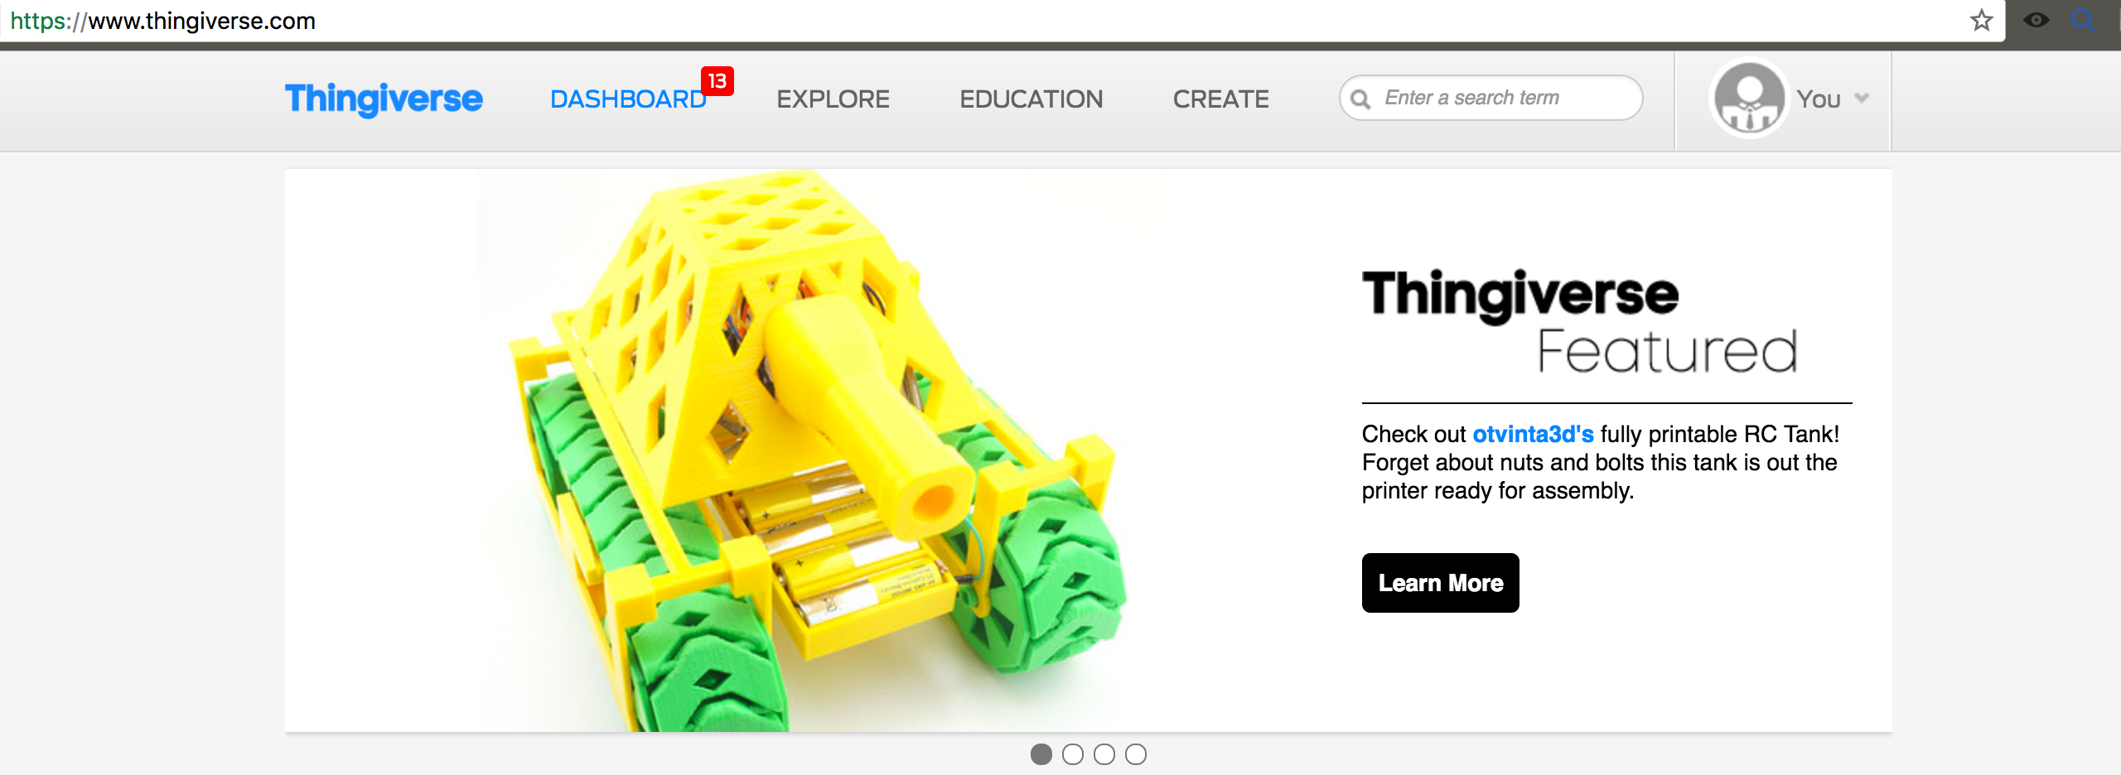
Pick something to print
https://www.thingiverse.com/

Slide 8
Or make it yourself
Fusion 360: https://www.autodesk.com/products/fusion-360/overview
Tinkercad: https://www.tinkercad.com/
OpenSCAD: http://www.openscad.org/

Slide 9
Slice it up!
Cura: https://ultimaker.com/en/products/cura-software
Silc3r: http://slic3r.org/
Craftware: https://craftunique.com/craftware/?page=craftware
Simplify 3D: https://www.simplify3d.com/

Slide 10
Start the print
Any old SD card
From your PC
OctoPi

Slide 11
And hope you don’t get something like….

Slide 12
Or something like….

Slide 13
Is this stuff safe?

